Slide 1
Theory of Higher-Order Regular Cuboids
COLL 134
Week 8

Slide 2
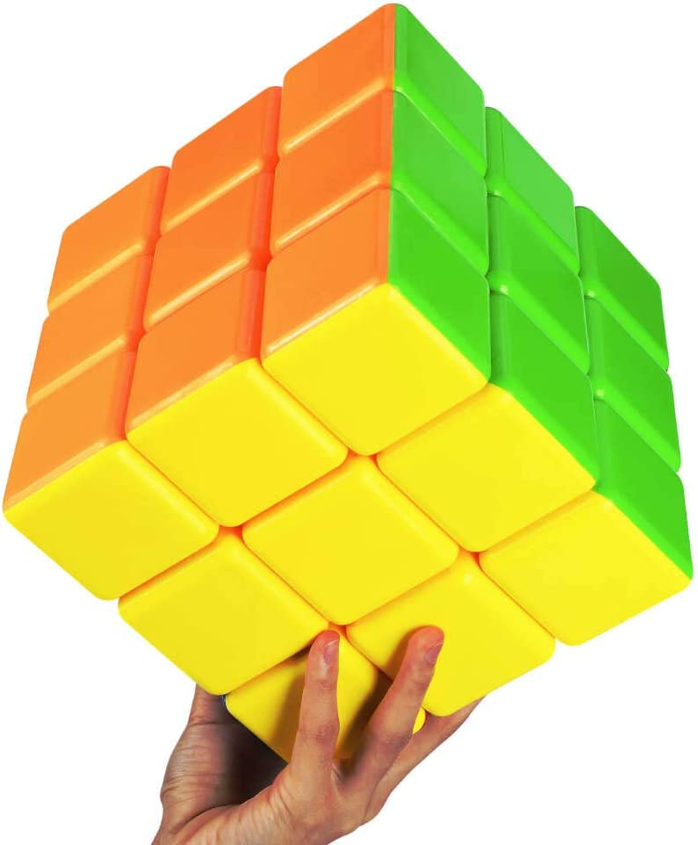
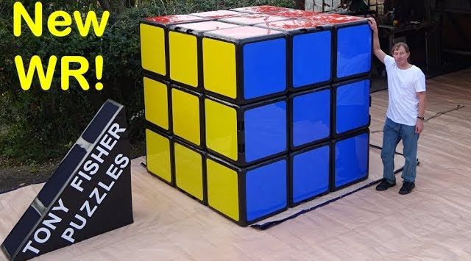
What’s In A Name?
Big cubes?

Slide 3
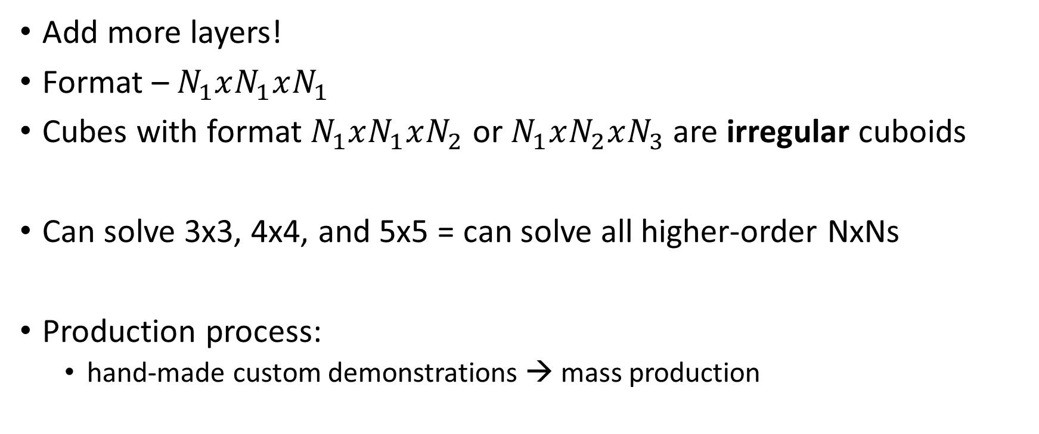
Types of Higher-Order Regular Cuboids
Add more layers!
Format – $N_{1}xN_{1}xN_{1}$
Cubes with format $N_{1}xN_{1}xN_{2}$ or $N_{1}xN_{2}xN_{3}$ are irregular cuboids
Can solve 3x3, 4x4, and 5x5 = can solve all higher-order NxNs
Production process:
hand-made custom demonstrations → mass production

Slide 4
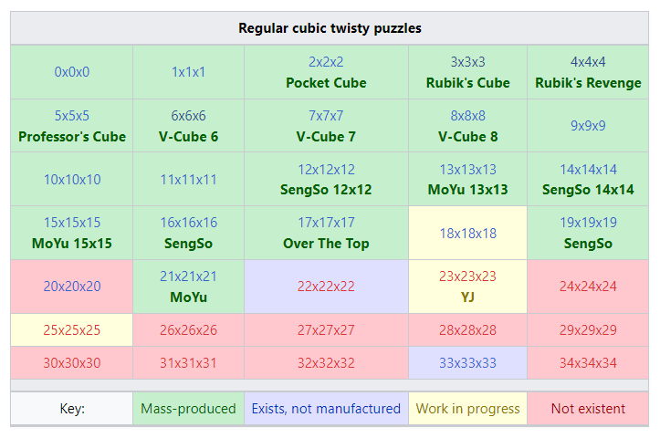
speedsolving.com/wiki

Slide 5
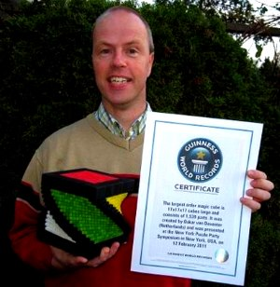
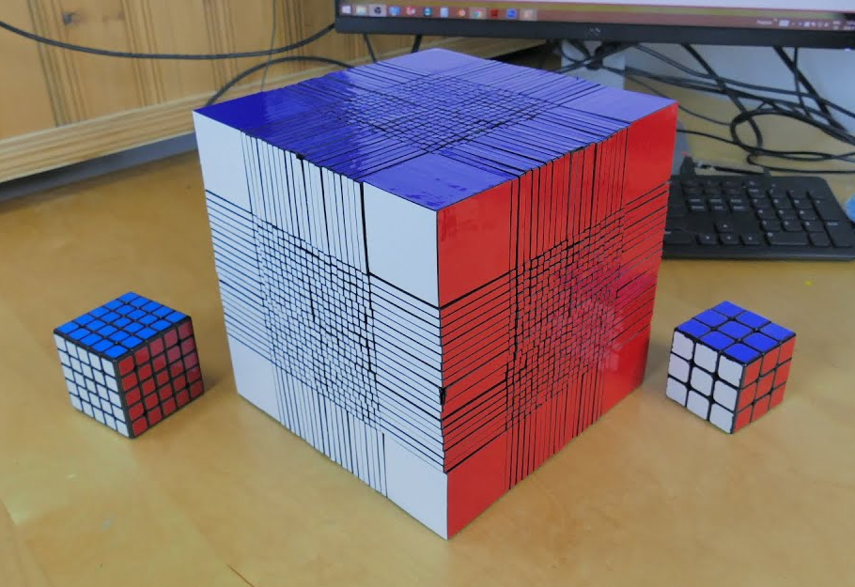
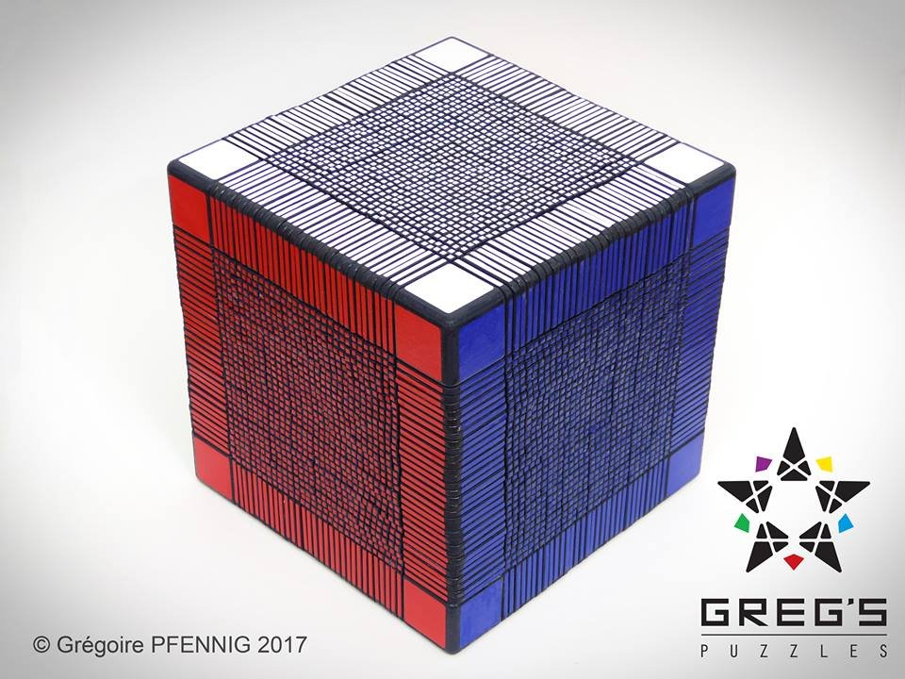
World Record NxNxNs
World record sizes: 17, 22, 33
Oskar van Deventer
17x17, 2011
corenpuzzle
22x22, 2016
Grégoire Pfennig
33x33, 2017

Slide 6
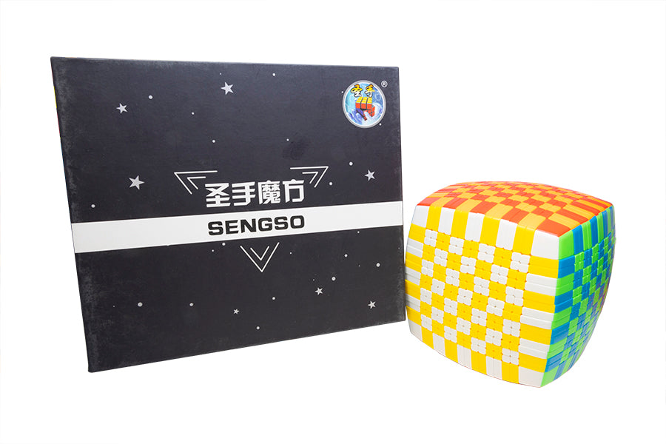
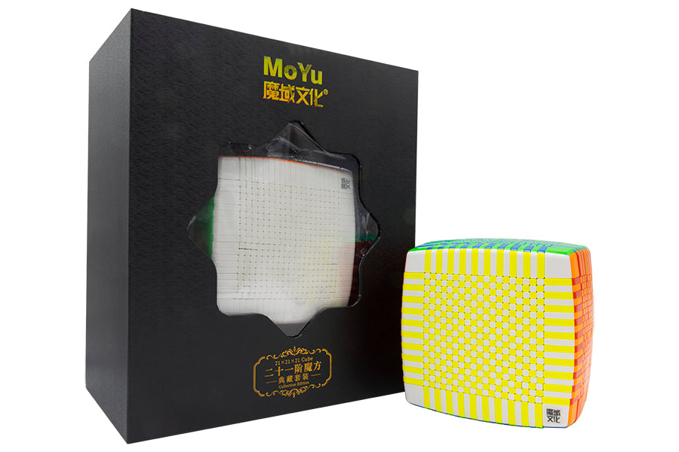
Mass Production NxNxNs
Currently in mass production: 2-17, 19, 21
SengSo 16x16
$500
Largest Even NxN
MoYu 21x21
$1500
Largest Odd NxN

Slide 7
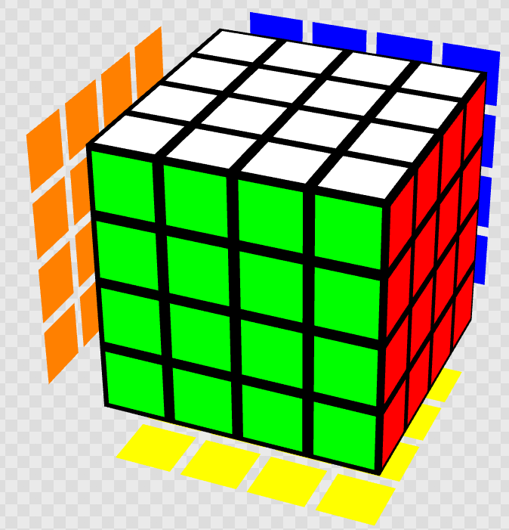
The 4x4
Invented in 1981 by Péter Sebestény
Aka Rubik’s Revenge, Rubik’s Master, Sebestény Cube
No centers for color reference
Most common solution methods: reduction and Yau
World record range: ~20 seconds

Slide 8
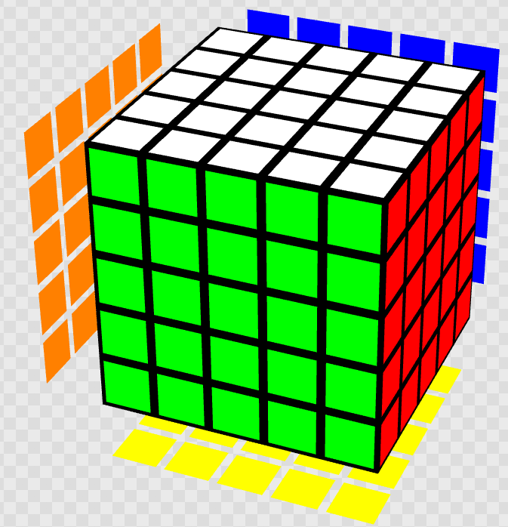
The 5x5
Invented in 1981 by Udo Krell
Aka Rubik’s Wahn (German for illusion/delusion), Professor’s Cube
Centers return for fixed color reference
Also popularly solved by reduction and Yau
World record range: ~40 seconds

Slide 9
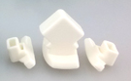
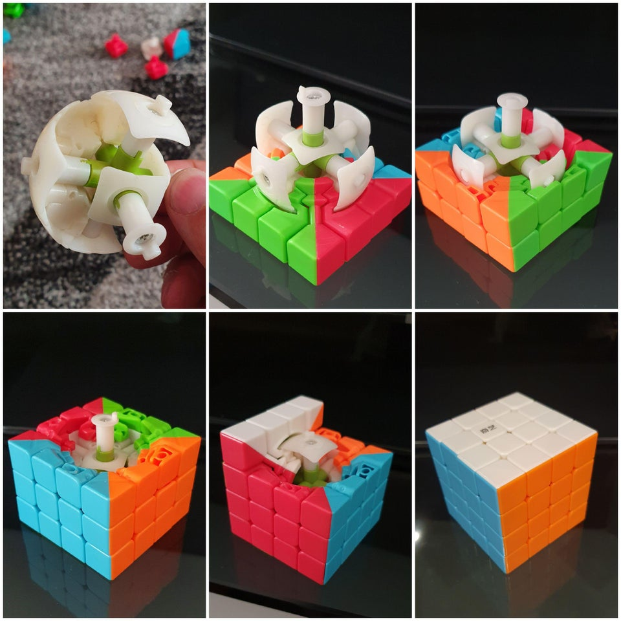
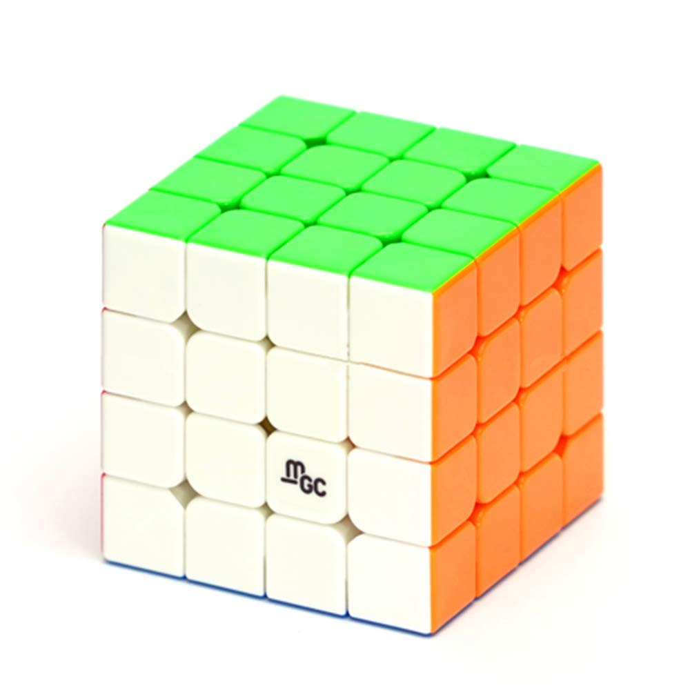
4x4 Structure
Core connects to internal centers
Internal centers are not visible from the outside
3 types of pieces:
Center (x24)
Indistinguishable
Edge (x24)
Corner (x8)
Internal edges fit between internal centers
External pieces wrap around internal pieces

Slide 10
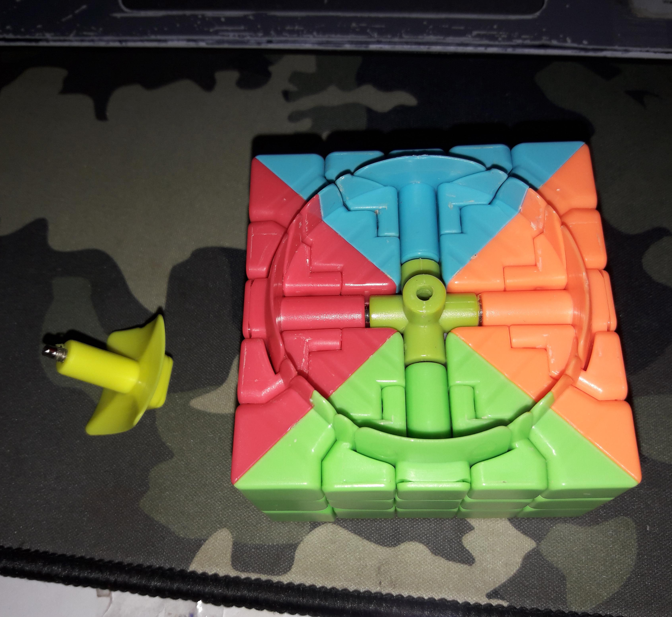
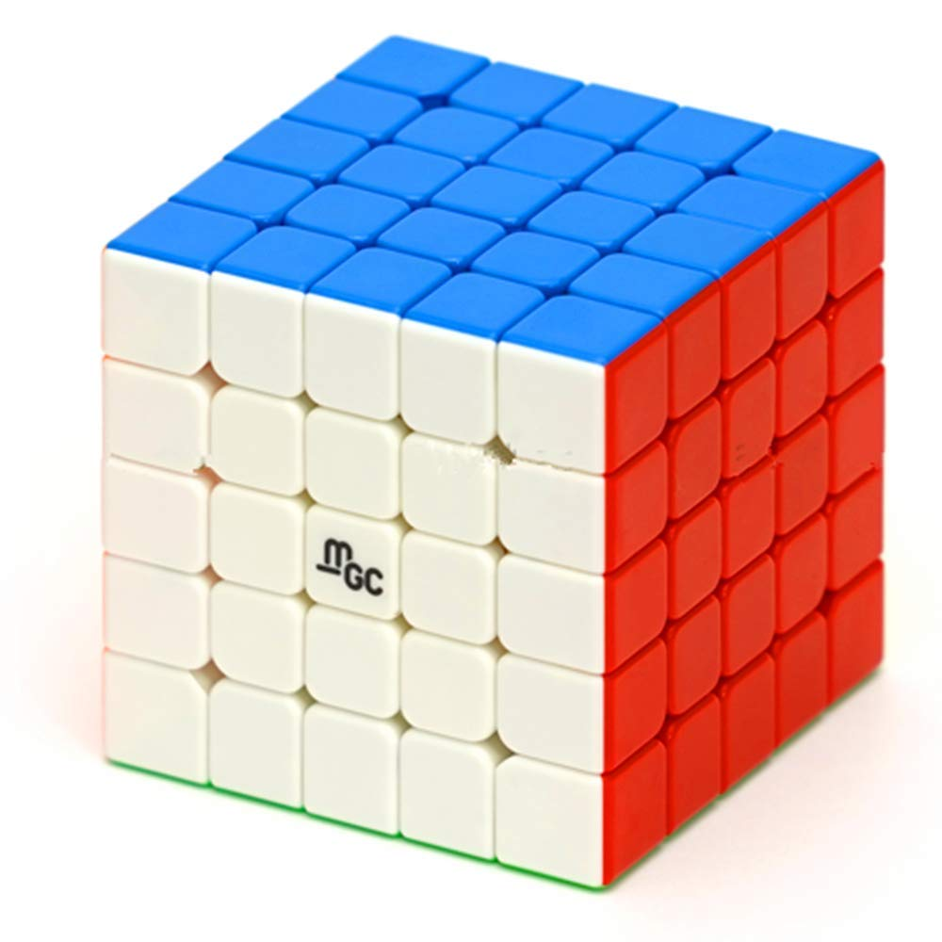
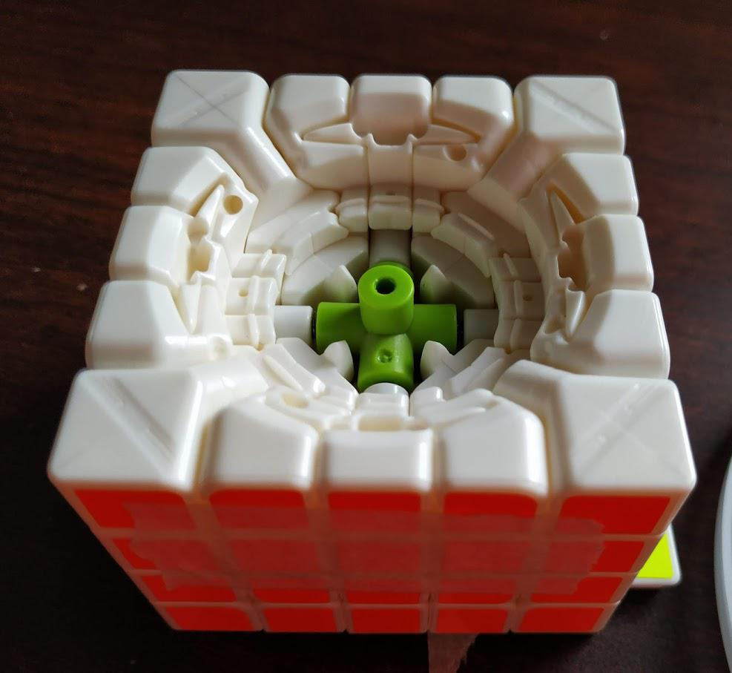
5x5 Structure
Internal core attaches directly to external central centers
External pieces wrap around external centers
6 types of pieces:
Central center (stationary, x6)
Edge center (x24)
Indistinguishable
Corner center (x24)
Indistinguishable
Inner edge (x12)
Outer edge (x24)
Corner (x8)

Slide 11
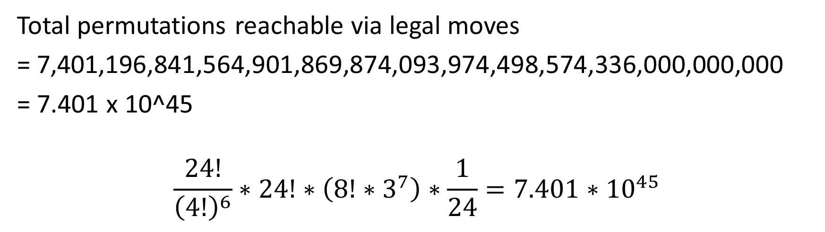
Possible Permutations of the 4x4
Total permutations reachable via legal moves
= 7,401,196,841,564,901,869,874,093,974,498,574,336,000,000,000
= 7.401 x 10^45
$$\frac{24!}{{\left(4!\right)}^{6}}∗24!∗\left(8!∗3^{7}\right)∗\frac{1}{24}=7.401∗{10}^{45}$$
Centers
Edges
Corners
Spatial Orientation
Total

Slide 12
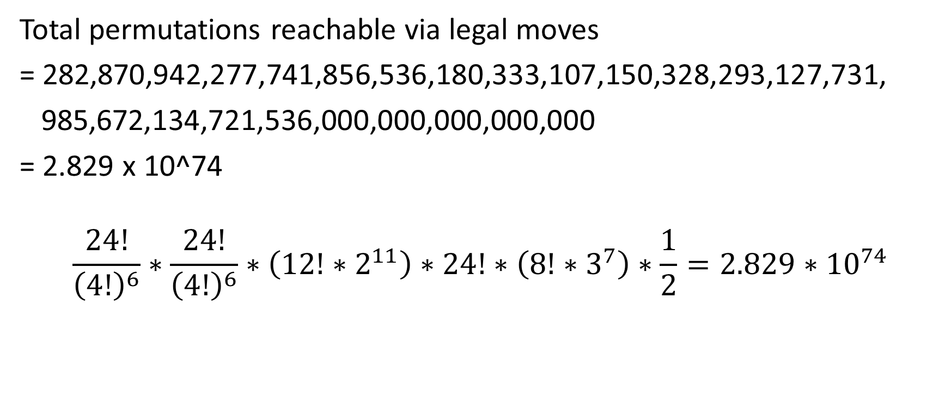
Possible Permutations of the 5x5
Total permutations reachable via legal moves
= 282,870,942,277,741,856,536,180,333,107,150,328,293,127,731,
985,672,134,721,536,000,000,000,000,000
= 2.829 x 10^74
$$\frac{24!}{{\left(4!\right)}^{6}}∗\frac{24!}{{\left(4!\right)}^{6}}∗\left({12!∗2}^{11}\right)∗24!∗\left(8!∗3^{7}\right)∗\frac{1}{2}=2.829∗{10}^{74}$$
Edge Centers
Corner Centers
Inner Edges
Outer Edges
Odd Parity
Corners
Total

Slide 13
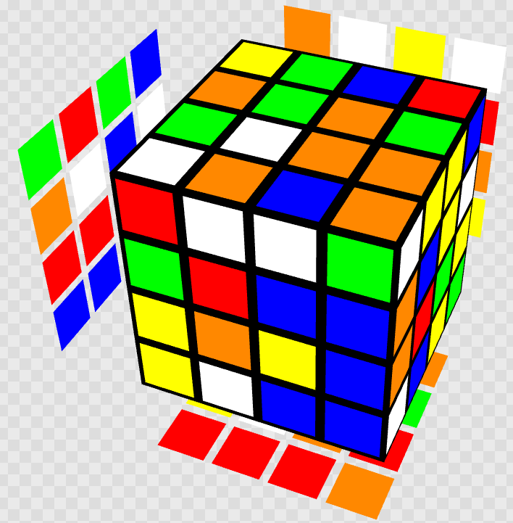
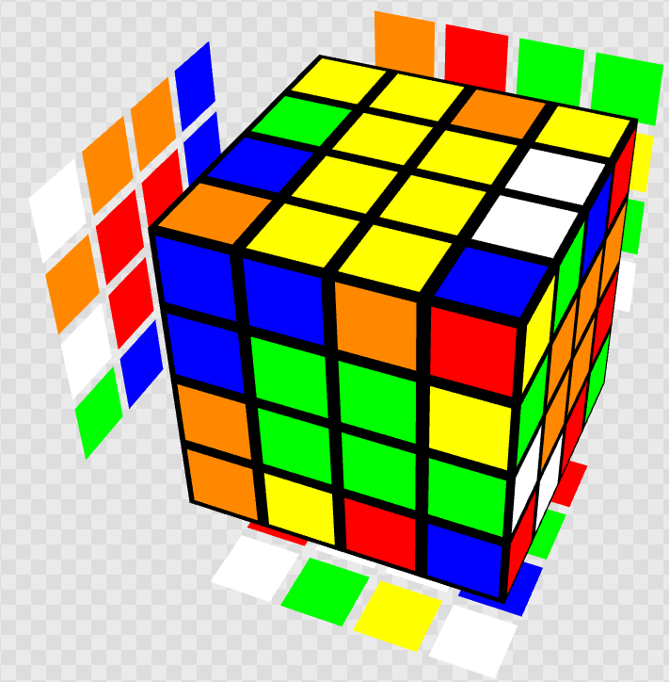
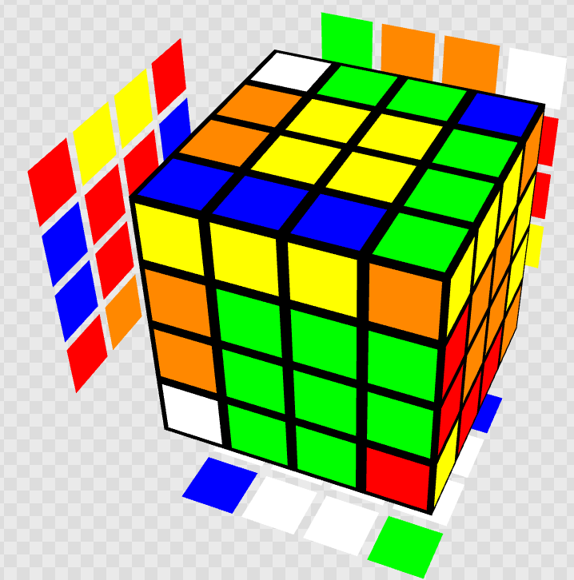
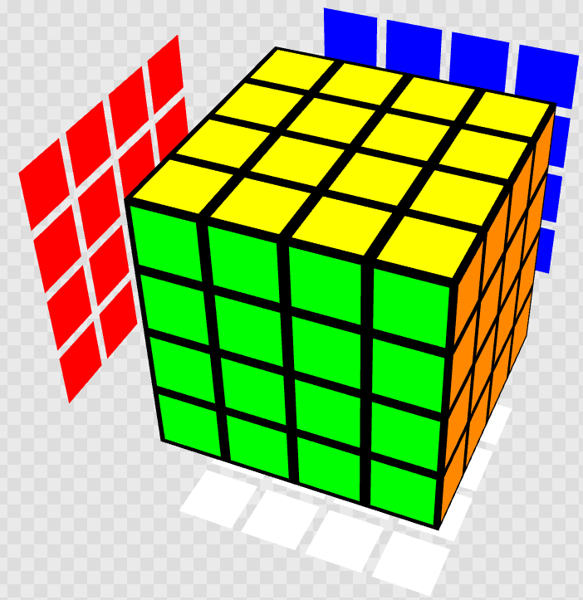
4x4 Solution Methods
Most popular and best for beginners – reduction method (redux)
“Reduce” 4x4 to 3x3
Advanced modifications of redux – Yau and Hoya
Solve centers
Solve edges
Solve 3x3

Slide 14
Redux vs Yau (Why Use Yau?)
Yau is most beneficial for people who solve 3x3 with CFOP
3x3 cross is completed with the centers
(+) Faster edge pairing – don’t need to look at bottom layer
(+) Faster 3x3 stage – can immediately start F2L after edge pairing
(-) Last 4 centers are harder to solve
Redux
Solve 2 opposite centers
Solve 4 remaining centers
Solve 12 edge pairs
Solve 3x3 stage
Yau
Solve 2 opposite centers (white/yellow)
Solve 3 white cross edge pairs
Solve 4 remaining centers
Solve 1 remaining white cross edge pair
Solve 8 edge pairs
Solve 3x3 stage (cross already done)

Slide 15
4x4 Notation
Main difference from 3x3 notation:
Need to account for greatly increased use of wide and slice turns

Slide 16
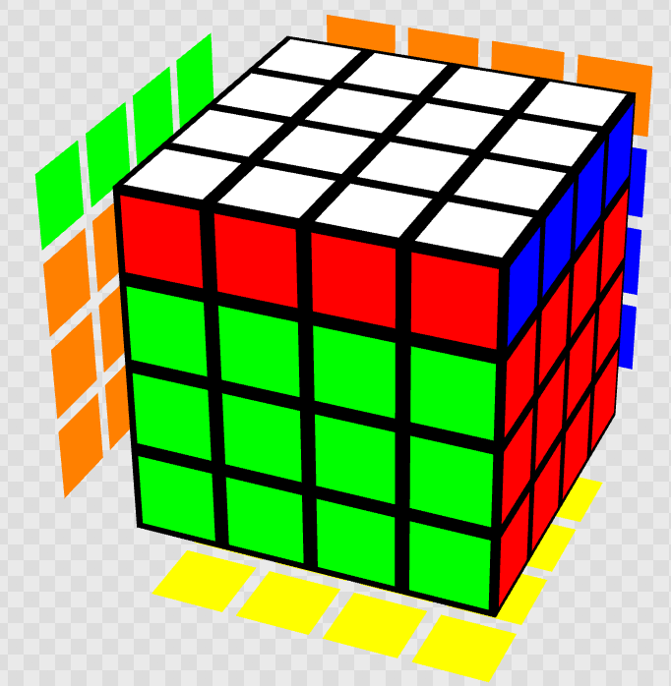
4x4 Notation – Outer Turns (Face)
N (uppercase letter)
Same as regular 3x3 face turns
U =

Slide 17
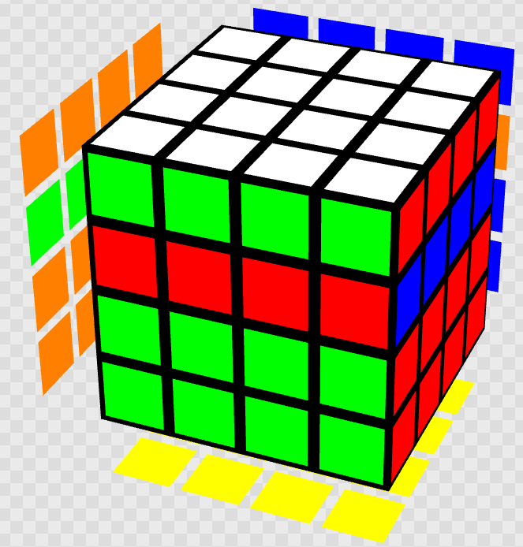
4x4 Notation – Inner Turns (Slice)
2N (“2” followed by uppercase letter)
Remember difference between 2N and N2
2U =

Slide 18
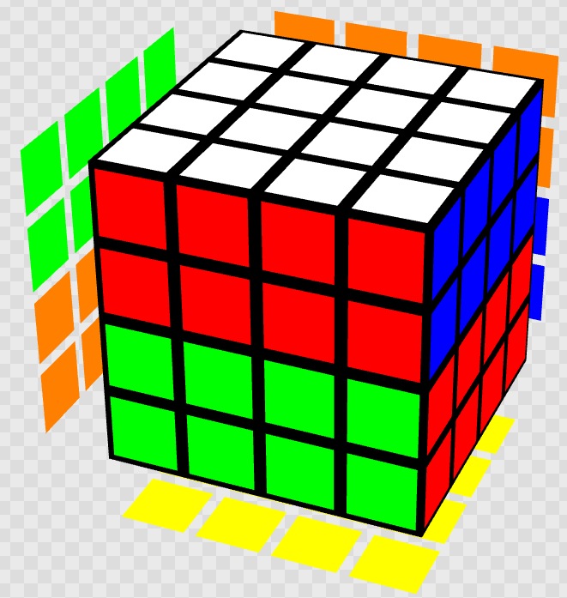
4x4 Notation – Wide Turns
Nw or n (uppercase letter followed by “w,” OR lowercase letter)
Both are accepted by simulators
Uw = u =

Slide 19
4x4 Notation – Rotations
x, y, and z
Same as 3x3 rotations

Slide 20
4x4 Notations – Complications
Notation here is for simulators
Some moves have alternative notation
In real life:
Wide turns typically noted exclusively by Nw
Inner turns typically noted by n instead of 2N

